Slide 1

Implementation of Location based Services in Android using GPS –Friend Finder Android app
Presented By:
Sanket.S.Kulkarni
1JT13CS042
Rakesh.S
1JT13CS036
Yashaswini. N
1JT13CS056
7thSemester(Computer Science and Engineering)
Jyothy Institute Of Technology
Guided By:
Harish.K
Jyothy Institute Of Technology

Slide 2


Contents
Introduction
Background
Implementation and methodology
Place Search
System Testing
Conclusion

Slide 3
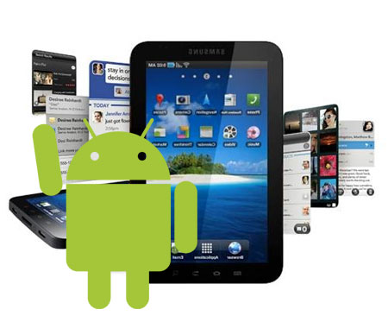
Introduction
The idea of using the mobile handsets and phones is to deliver the valuable services except the basic communication that had been started in the early 1990s when Internet was added in Voice Telephony
Location-based services refer to ‘ a group of applications that exploit the knowledge of the geographical position of a mobile device in order to provide services based on that information.’

Slide 4
Location-based services (LBS) provide the mobile clients personalized services according to their current location.
They also open a new area for developers, cellular service network operators, and service providers to develop and provide value-added services: advising clients of current traffic conditions, providing routing information, helping find the friends and informing they are safe and helps in maintaining many security based services through android apps via GPS Services

Slide 5
Background
In the last few years, the smart phones (Android,Black berry and iPhone) have taken over the market of Nokia based Symbian Phones in India. And these smart phones come equipped with a GPS functionality which provides the spatial coordinates of the user location.
Android's Network Location Provider determines user location using cell tower and Wi-Fi signals, providing location information in a way that works indoor and outdoor, responds faster, and uses less battery power.

Slide 6
Assisted GPS , also known as A -GPS or AGPS, improves the performance of standard GPS in devices connected to the wireless network.
A-GPS enhances the locationgranularity of cell phones (and other connecteddevices) in two ways:
By helping position mobile device when GPS signals are not strong or not present. GPS satellite signals may be impeded by tall towers,and they do not penetrate building interiors well.
A-GPS uses proximity to cellular towers to calculate location when GPS signals are unavailable.
It addresses signal and wireless network problems by using assistance from other services.
Such a technology in our smart phones can assist in various ways like tracking current location, receiving turn-by-turn direction instructions, route tracking, etc.

Slide 7
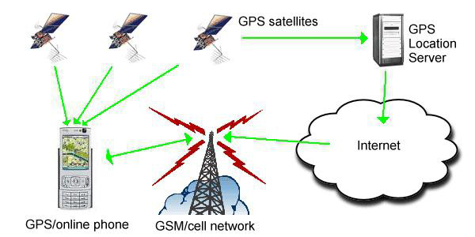
GPS is real-time solution provider whereas AGPS is not.
The network usage is required every time we move out of the service area.
It is useful only for locating a particular place in small area. There is no privacy in GPS and A-GPS since the Assistance server knows the location of the device.
There needs to be communication over the wireless for processing of GPS information so this could be expensive.
Figure : GPS architecture

Slide 8
Implementation and Methodology
Location-based service is another key functionality that gets used in smart phone applications.
It is often combined with maps to give a good experience to the user about their location.
Android support LBS Application Programming Interfaces (APIs) . Location service allows finding out the device current location.
The application can request for periodic update of the device location information.
The application can also register a intent receiver for proximity alerts like when the device is entering and existing from an area of given longitude, latitude and radius.

Slide 9
Android Location API These are the different classes present under Location API package to retrieve the Location information of the user.
Location Manager- The class provides access to the location service. It also provides facility to get the best Location Provider as per the criteria.
Location Provider- It’s an abstract super class forlocation providers. A location provider provides periodic reports on the geographical location of the device.
Location Listener- This class provides callback methods which are called when location gets changed. The listener object has to be registered with the location manager.
Criteria- The class provides the application to choose suitable Location Provider by providing access to set of required properties of the Location Provider.

Slide 10
Android also provide an API to access the google maps. So with the help of the google maps and the location APIs the application can show required places to the user on the map.

Slide 11
Place Searches
A Place Search request is an HTTP URL
defined in the following way :
https://maps.googleapis.com/maps/api/place/search/output?arguments
Where output may be either of the following values
Json shows the response in JavaScript Object Notation
(JSON) .xml shows output as XML

Slide 12
System Testing
We developed the mobile application on
Android covering all the mentioned APIs and
the application was tested using Samsung
S5or any mobile phone(which is A-GPS
enabled handset).
android.permission.ACCESS_COARSE_LOCATION

Slide 13
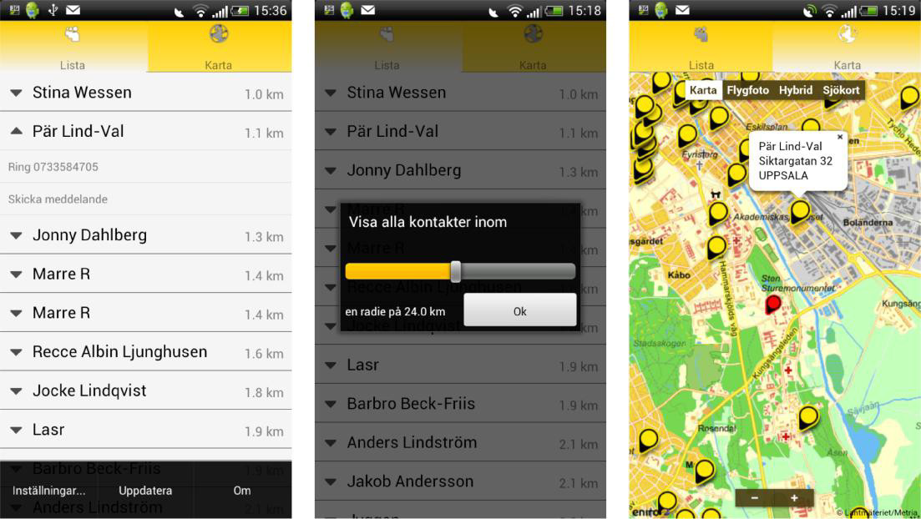
(a) List view (b) Radius setting dialog (c)Map
view
Figure 2- Screen showing a) Place Search Results b) Place
Details using Google Places API c) Public Transit using
Walk Score API

Slide 14
Conclusion
The various constraints to implement location based services are-
Technology Constraints
For LBS to be operational on a large scale, mapping under the geographical information system (GIS) needs to be more comprehensive than it is today. This raises significant challenges in for improving the breadth and the depth of the existing coverage of GIS.
Defnation of GIS:A geographic information system (or GIS) is a system designed to capture, store, manipulate, analyze, manage, and present spatial or geographical data
Infrastructure Constraints
One of the main problems is the lack of spread of the
wireless network into the countryside.
In developing country like India, the wireless technology is in very
nascent stage.
In metro cities and areas, the problem of network congestion is also an important issue.

Slide 15
Market Failure
One of the main constraints to the provision of value
added services, in general, and LBS in particular, is
the market structure of the mobile industry and the
failure to unleash the forces of competition

Slide 16
References
Location Based Services on Mobile
in India For IAMAI - Version: 14
April 2008
http://www.iamai.in/Upload/policy/LBS_Draft_I
ndicus
.pdf
J2ME and Location based
Services By Qusay H.
Mahmoud - March 2004
http://developers.sun.com/mobility/apis/articles/location
Location Based Services By Valerie Bennett
http://www.ibm.com/developerworks/ibm/library/i-lbs

Slide 17
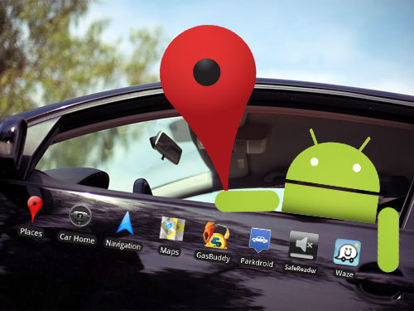
ANY QUERIES…
?

